Slide 1
ntree_insert.c, path_exists.c, and ntree_free.c github path for files: https://github.com/johndspence/holbertonschool-low_level_programming/tree/master/n_trees
Logic and Code Review
Holberton School
20160816
John Spence

Slide 2
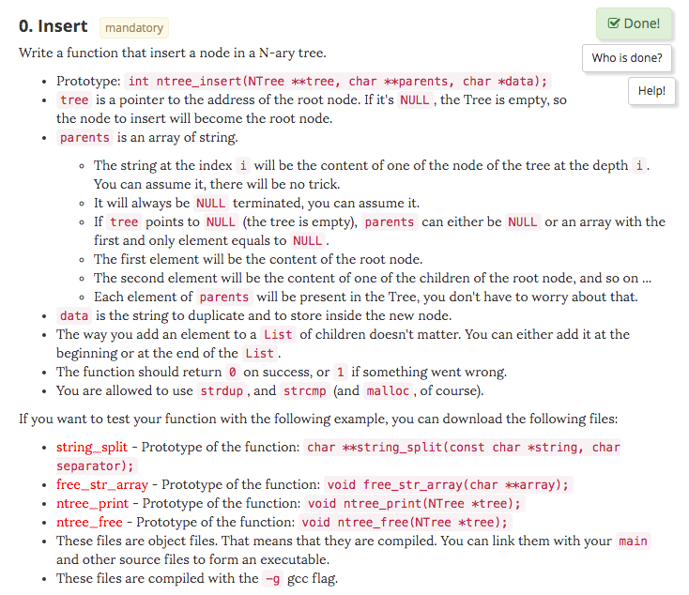
ntree_insert.c Task

Slide 3
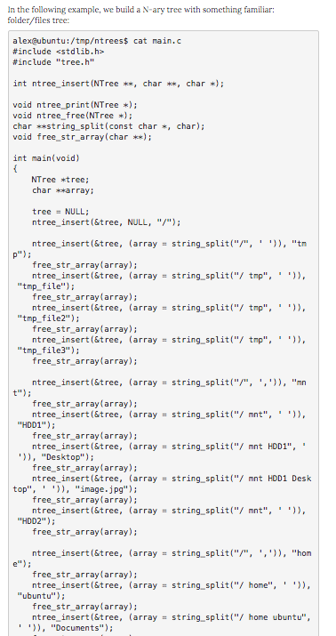
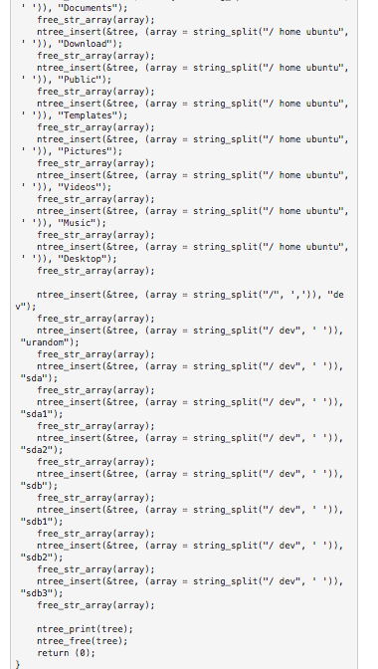
ntree_insert.c Task: Example main.c

Slide 4
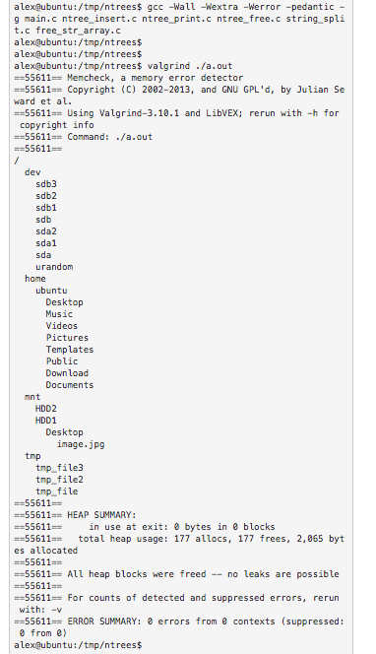
ntree_insert.c Task: Expected Output

Slide 5
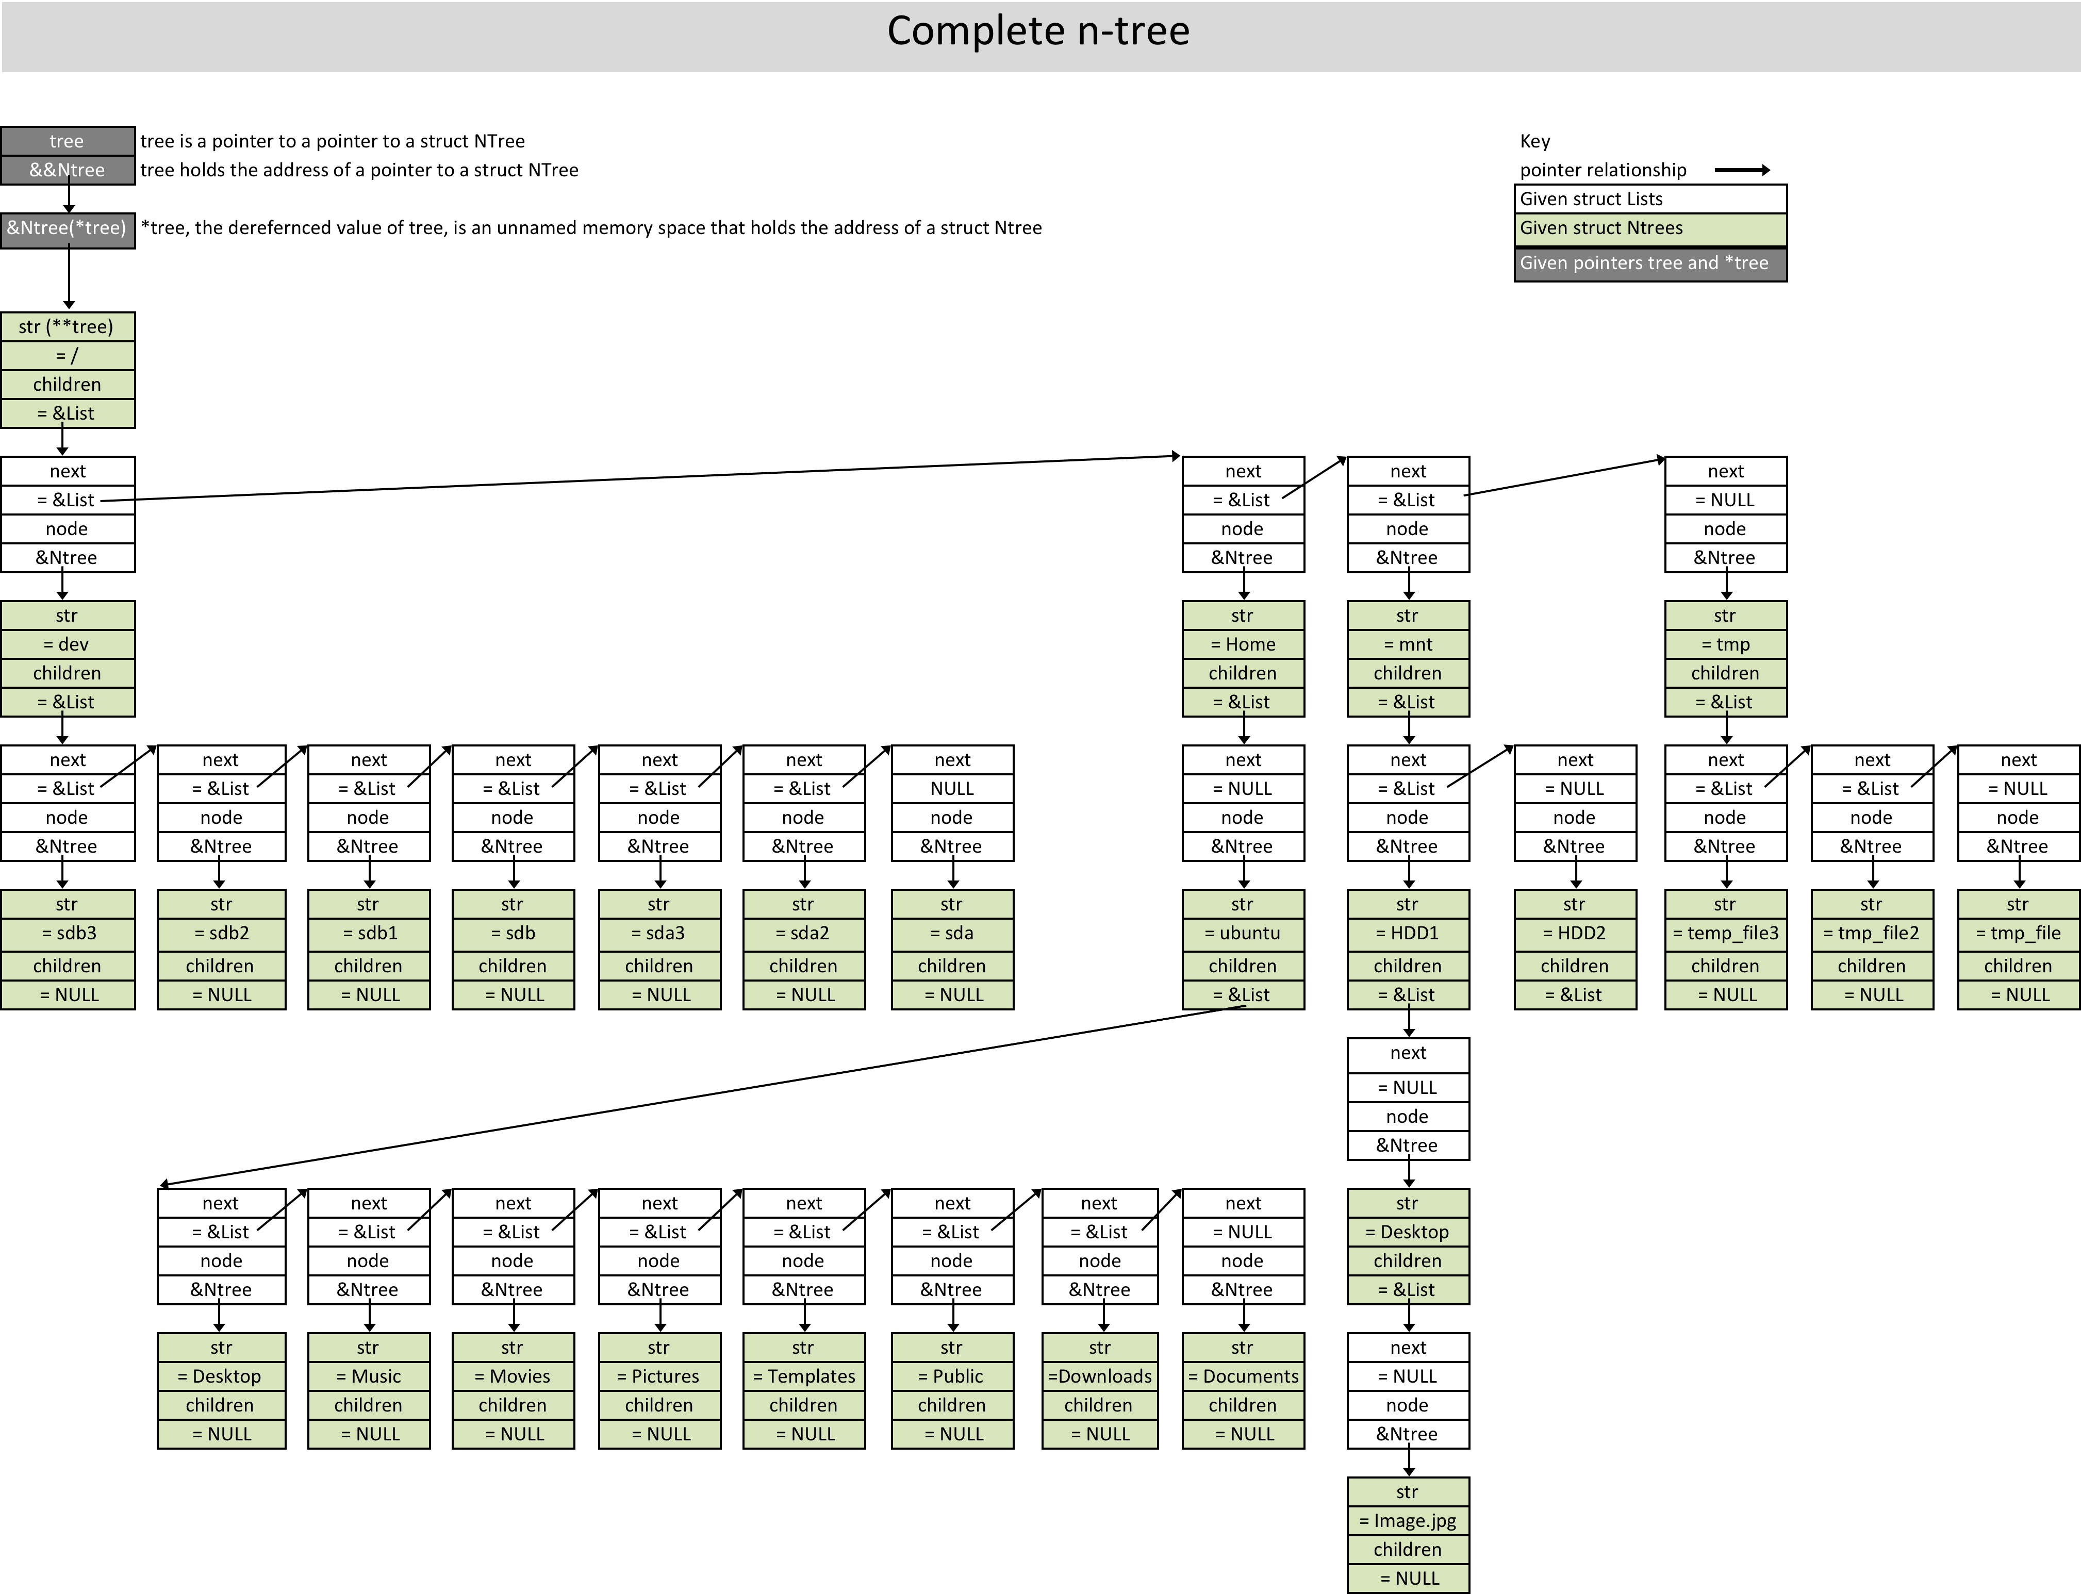
Complete n-tree

Slide 6
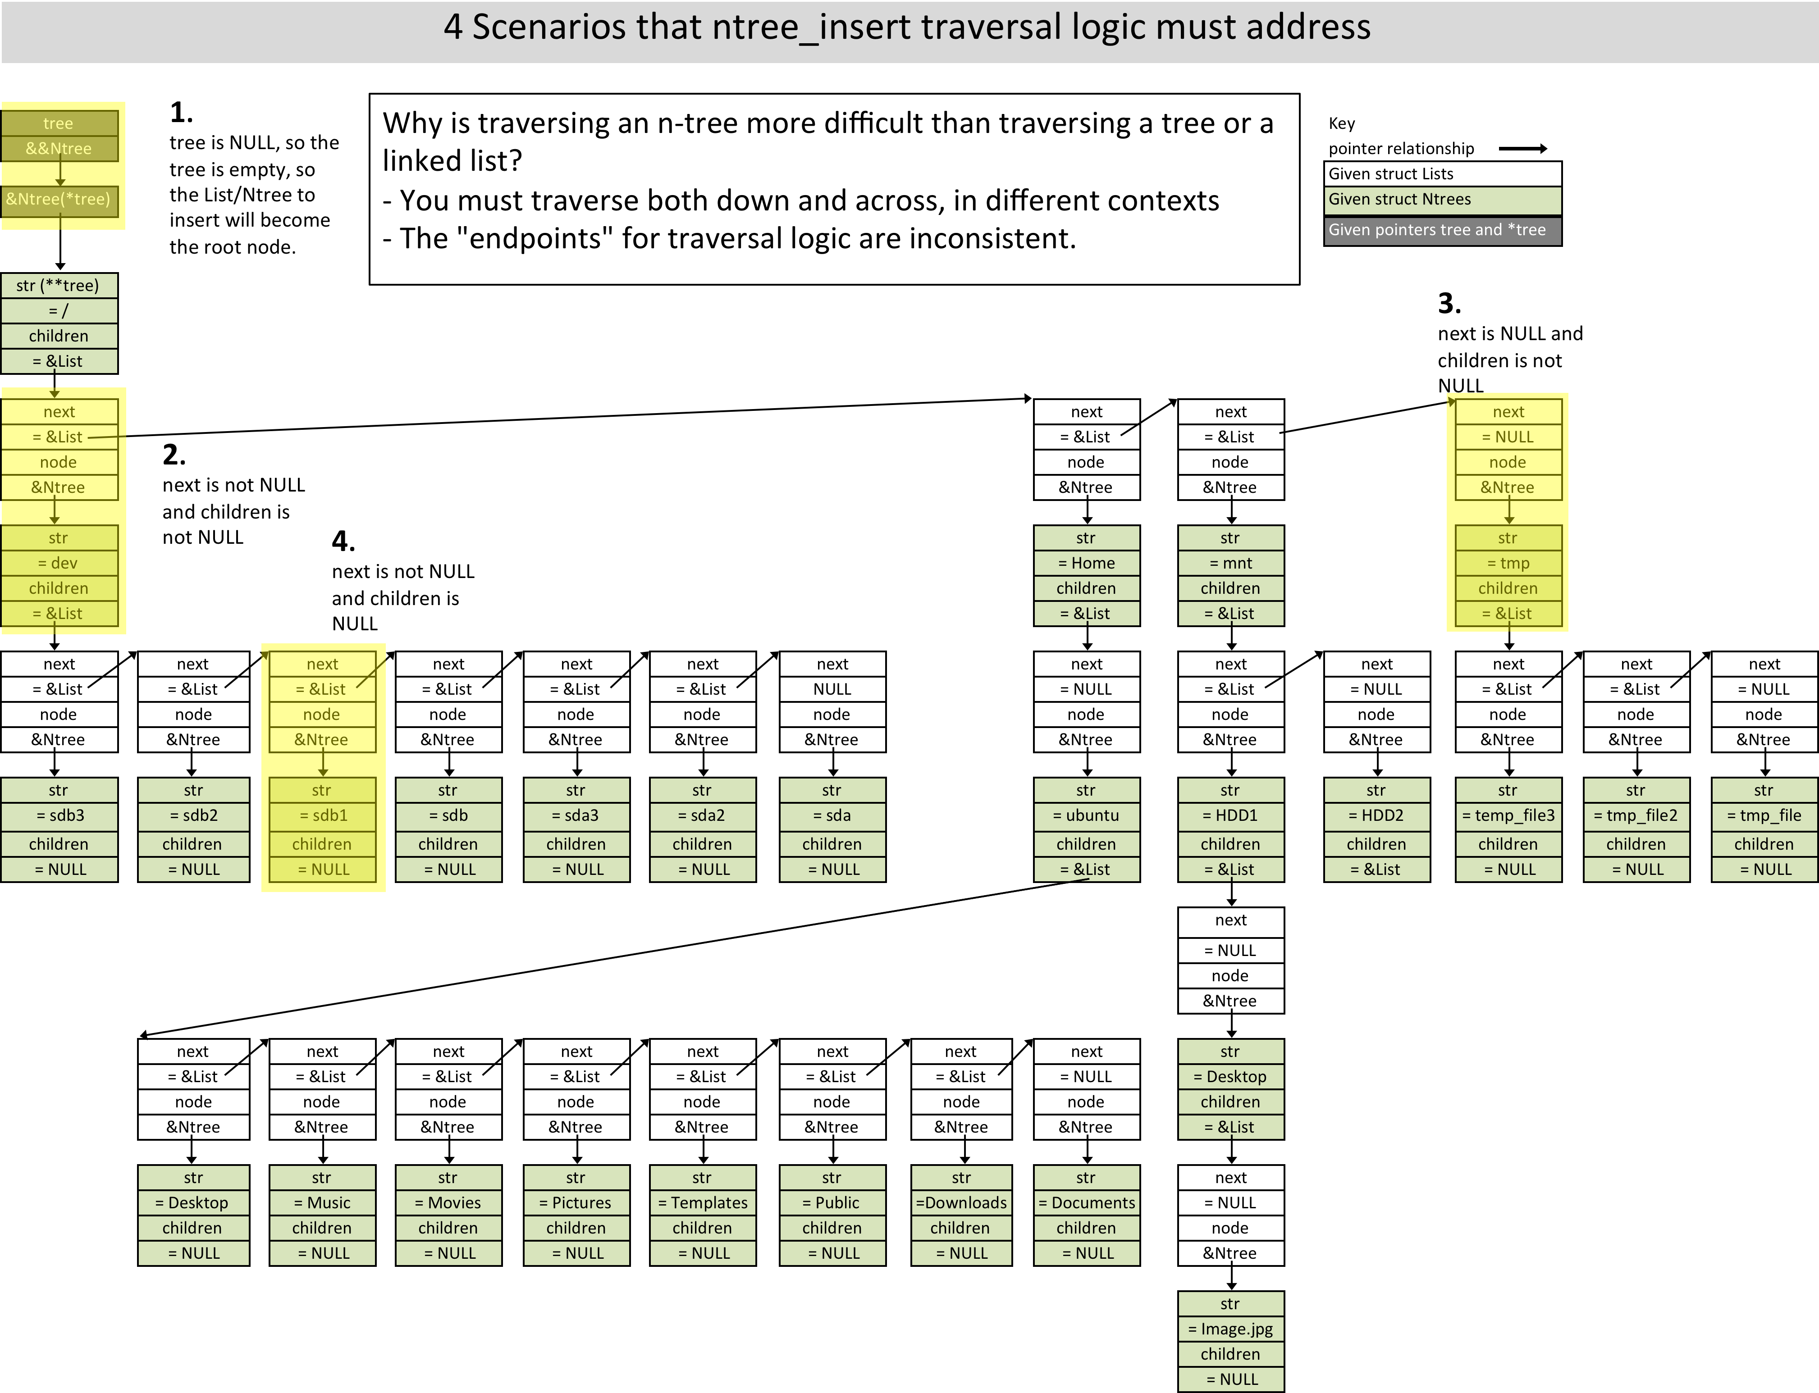
4 Scenarios that ntree_insert traversal logic must address

Slide 7
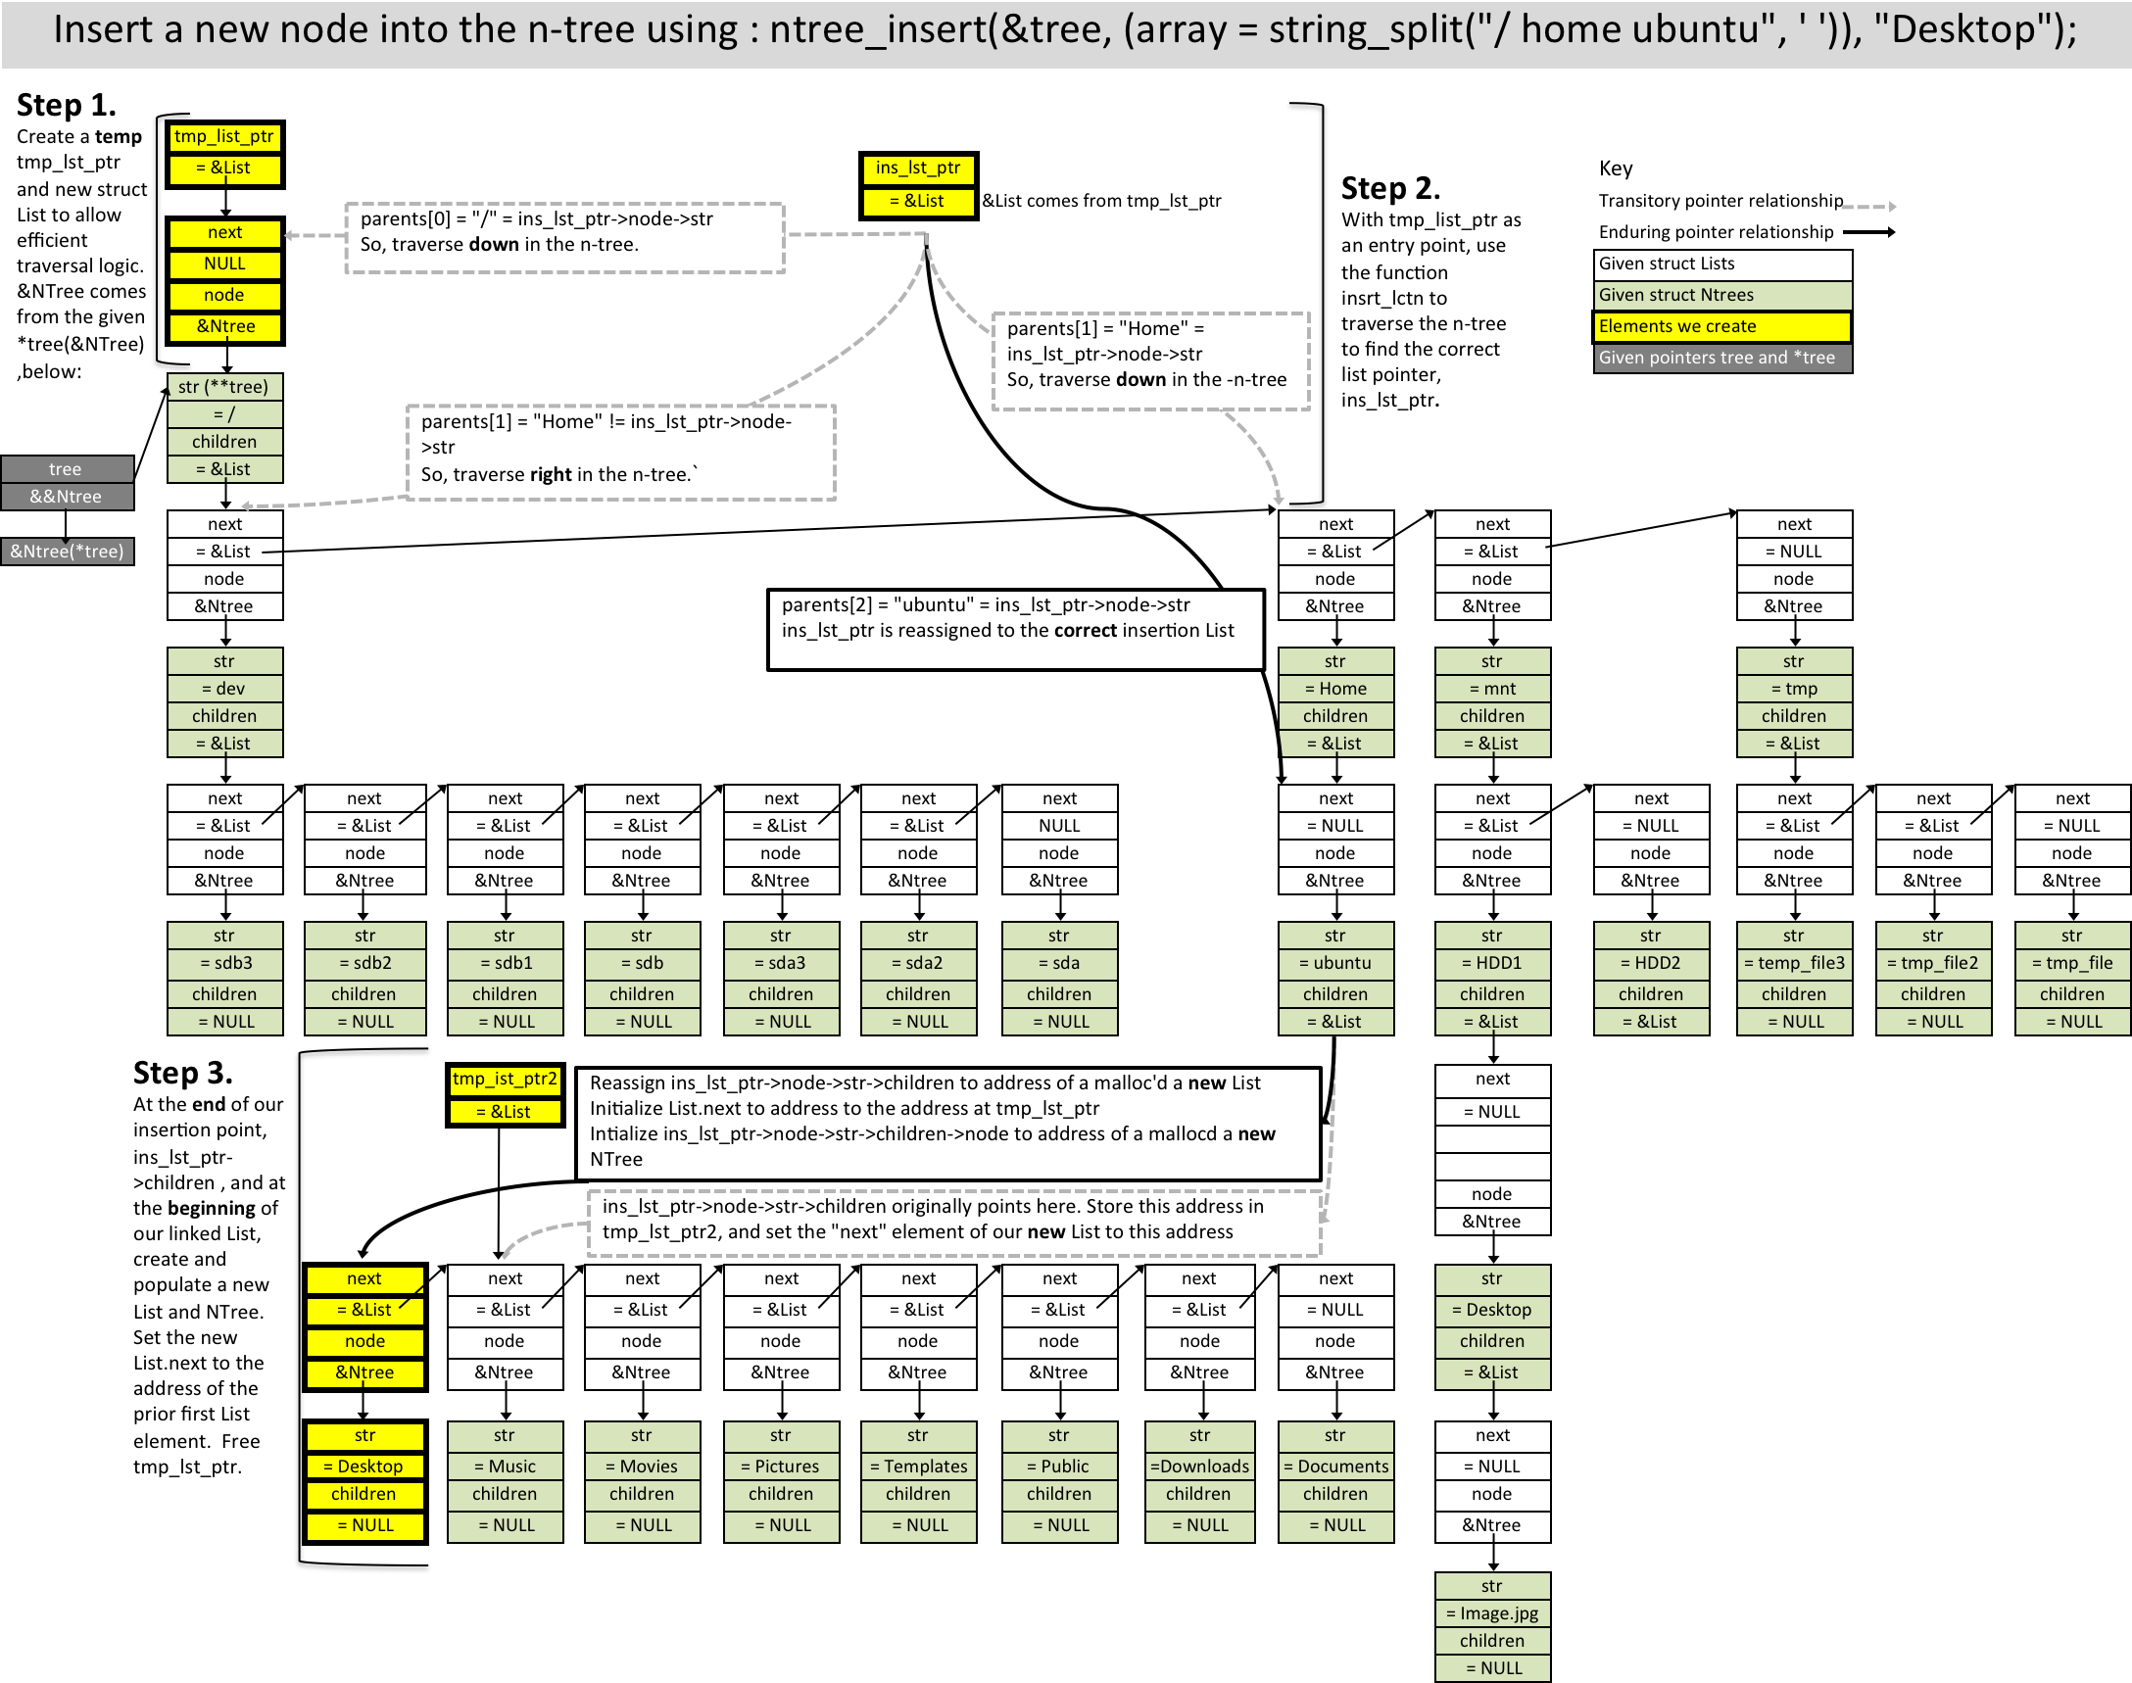
Insert a new node into the n-tree

Slide 8
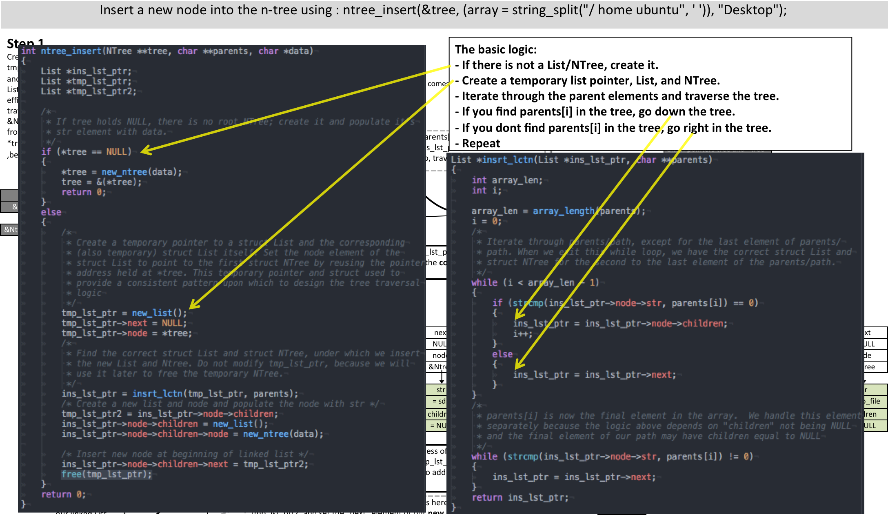
Insert a new node into the n-tree: code

Slide 9
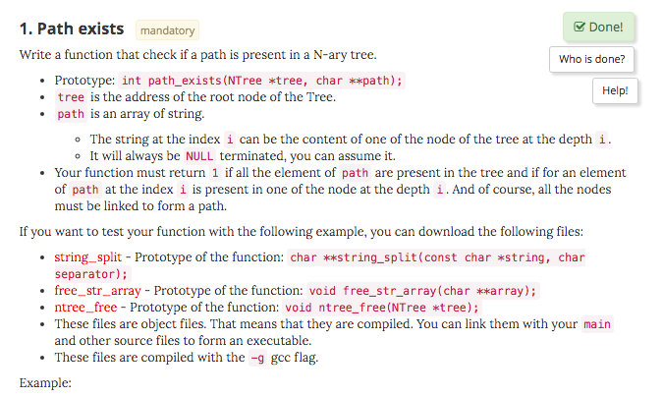
path_exists.c Task

Slide 10
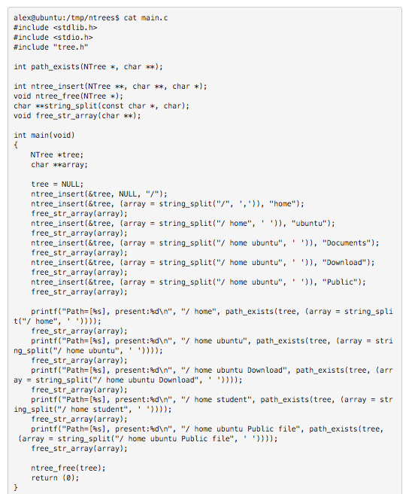
path_exists.c Task: Example main.c

Slide 11
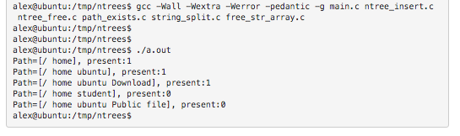
path_exists.c Task: Expected Output

Slide 12
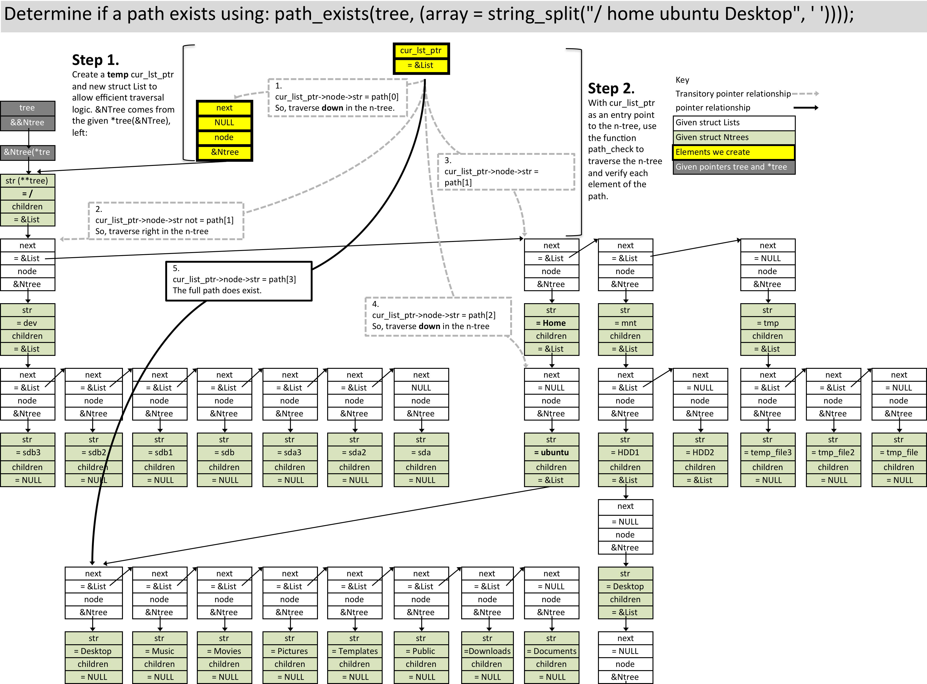
Determine if a path exists using: path_exists in an n-tree

Slide 13
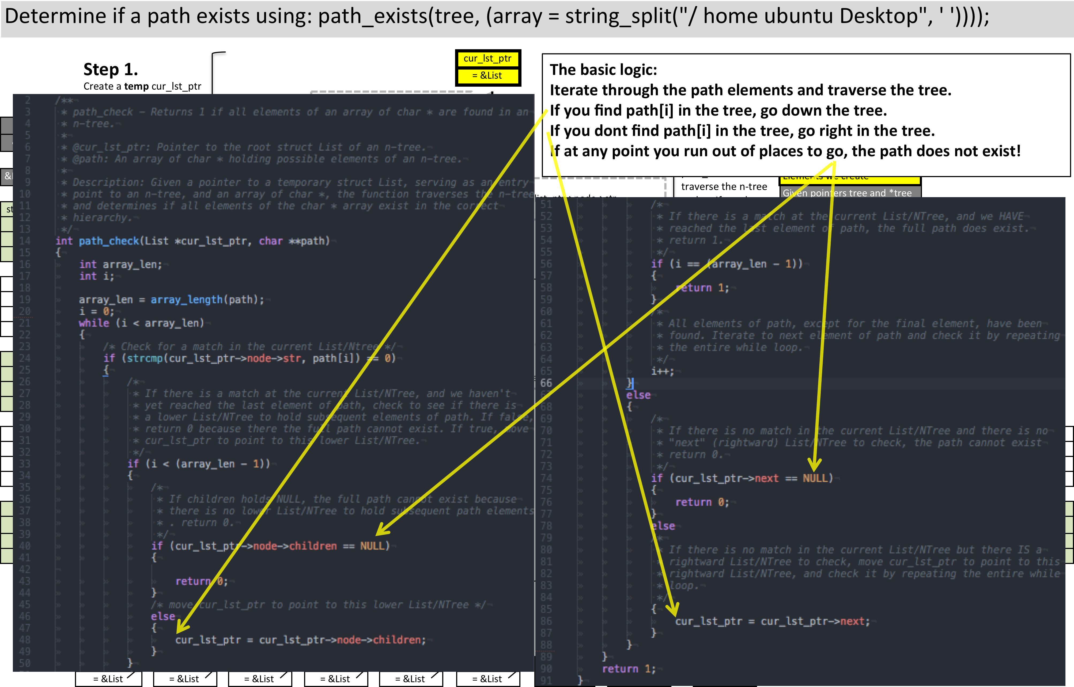
Determine if a path exists in a n-tree: code

Slide 14
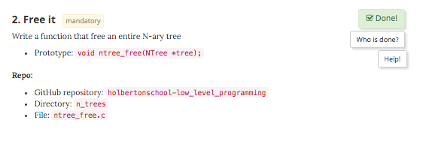
ntree_free.c Task

Slide 15
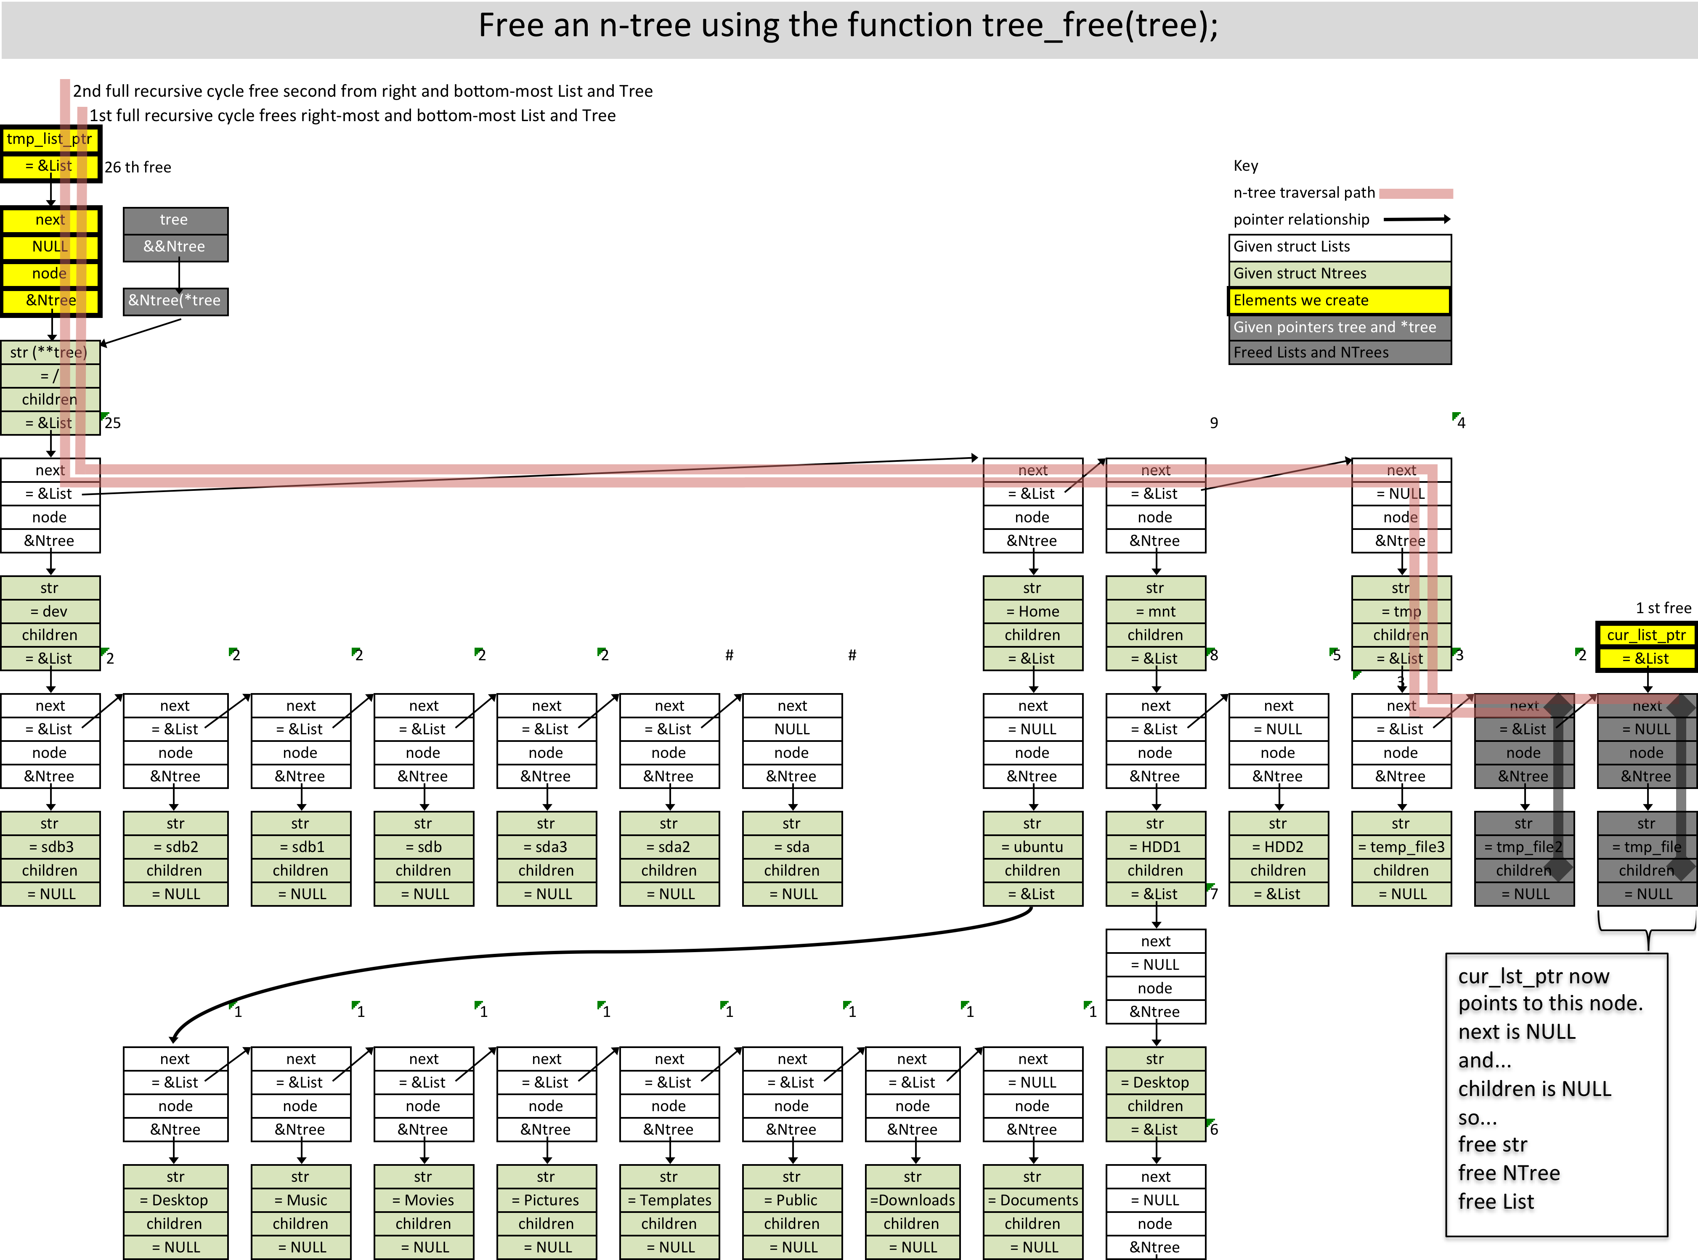
Free an n-tree

Slide 16
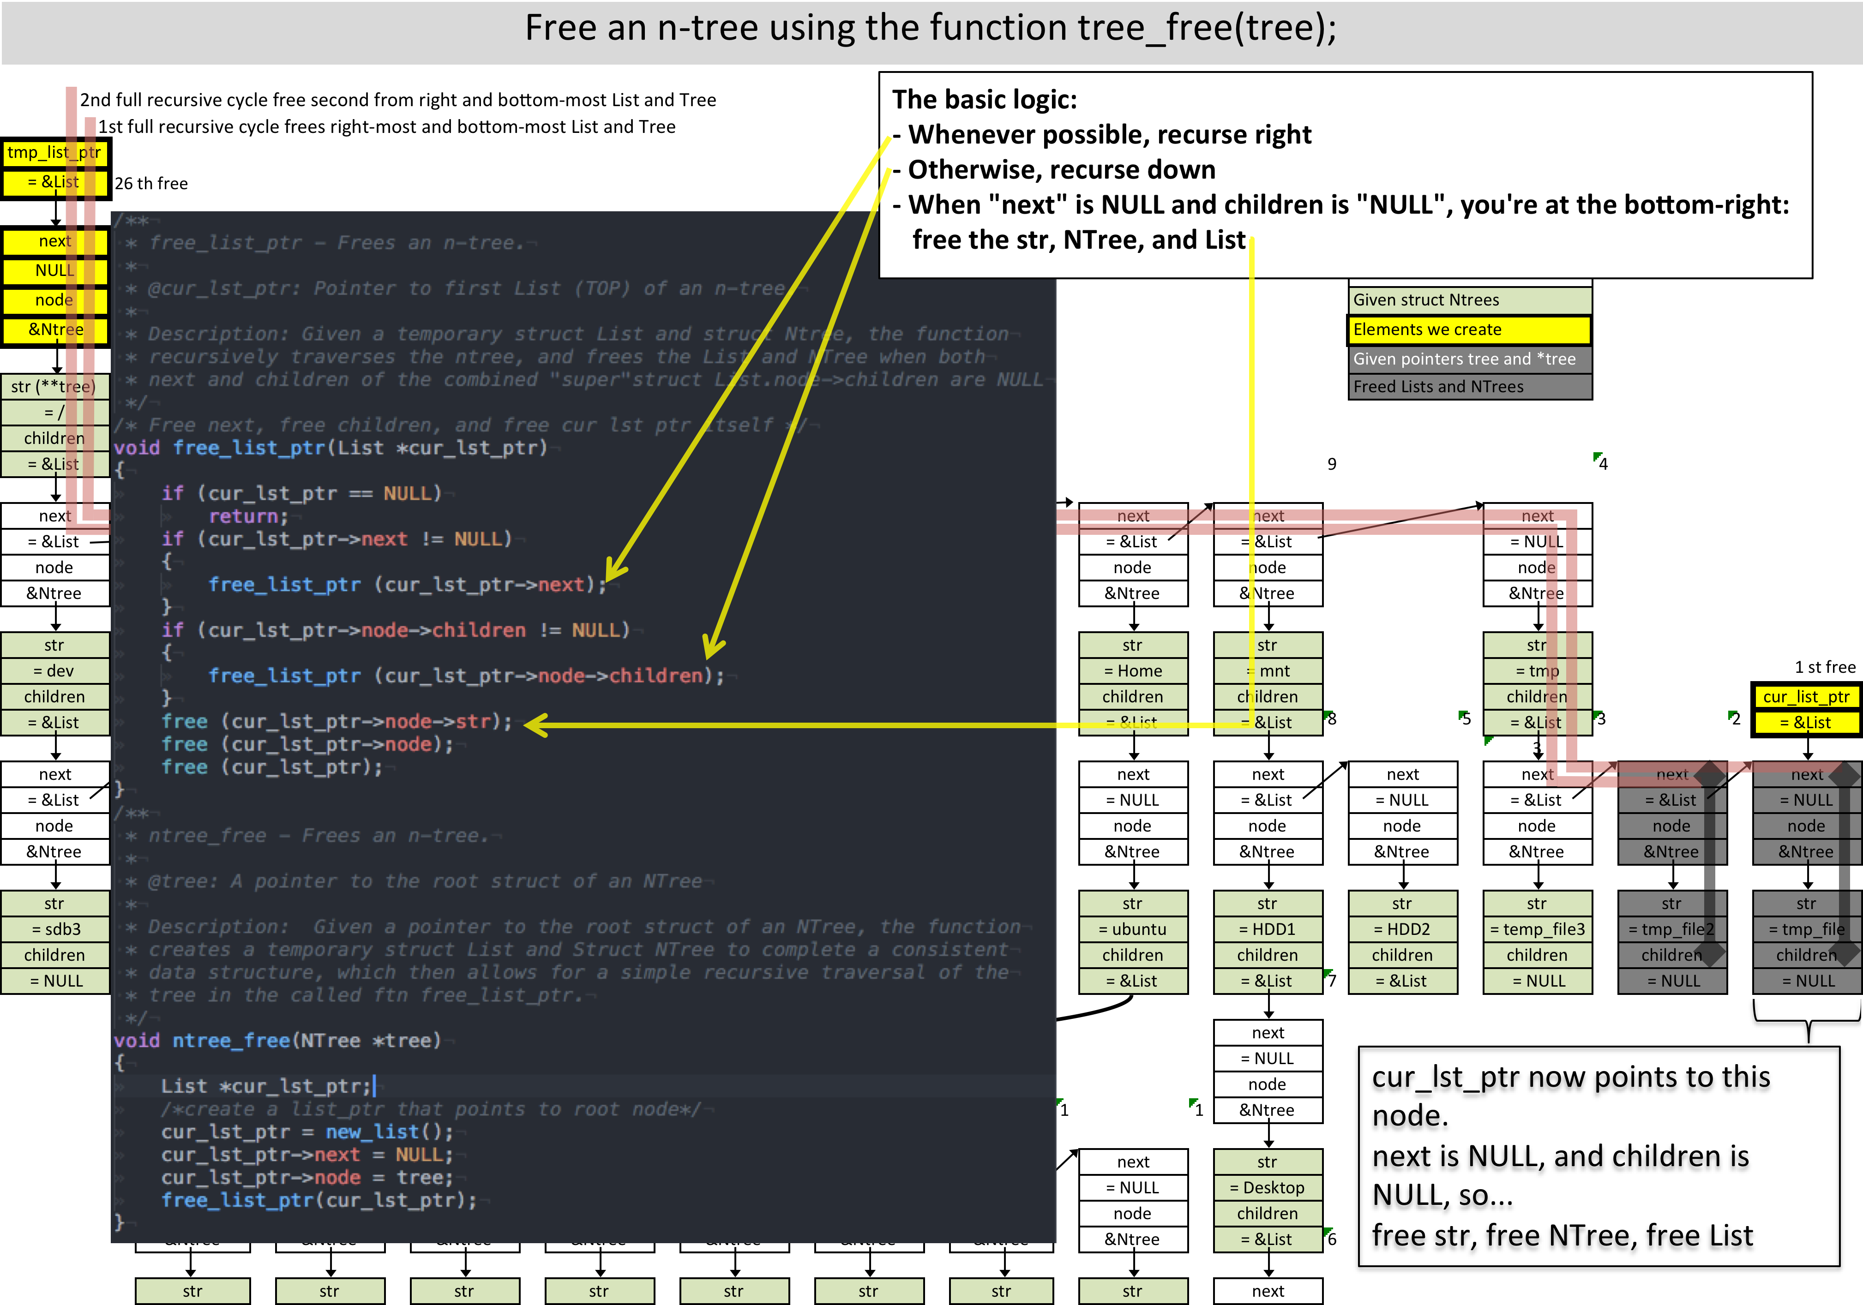
Free an n-tree: code

